Slide 1
“…all the men and women merely players” – Theatre ticket sales analysis in R
library(dplyr)
rladies_global %>%
filter(city == ‘London')

Slide 2


Who am I?
By day: CRM Analyst @ Hotels.com, crunching numbers
By night: theatre enthusiast, (not) going to plays

Slide 3
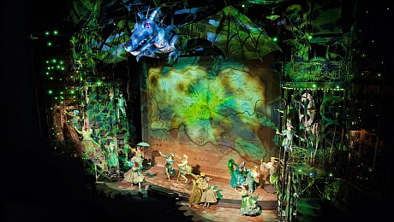
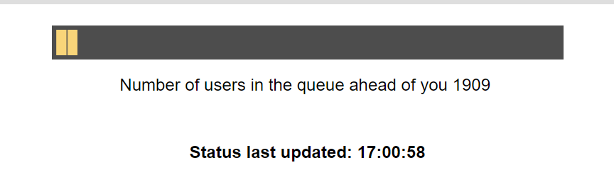
My theatre experience in London
Either too expensive
Or too popular
Or too hard to understand
Workaround: go to a play every time you are in Budapest!
Task: to predict which are the plays which will not be sold too quickly?

Slide 4
Approach
1
Scrape the website periodically to figure out which play is sold out when
2
Collect information about the plays to have some features to work with
3
Build a simple model on April + validate it on June

Slide 5
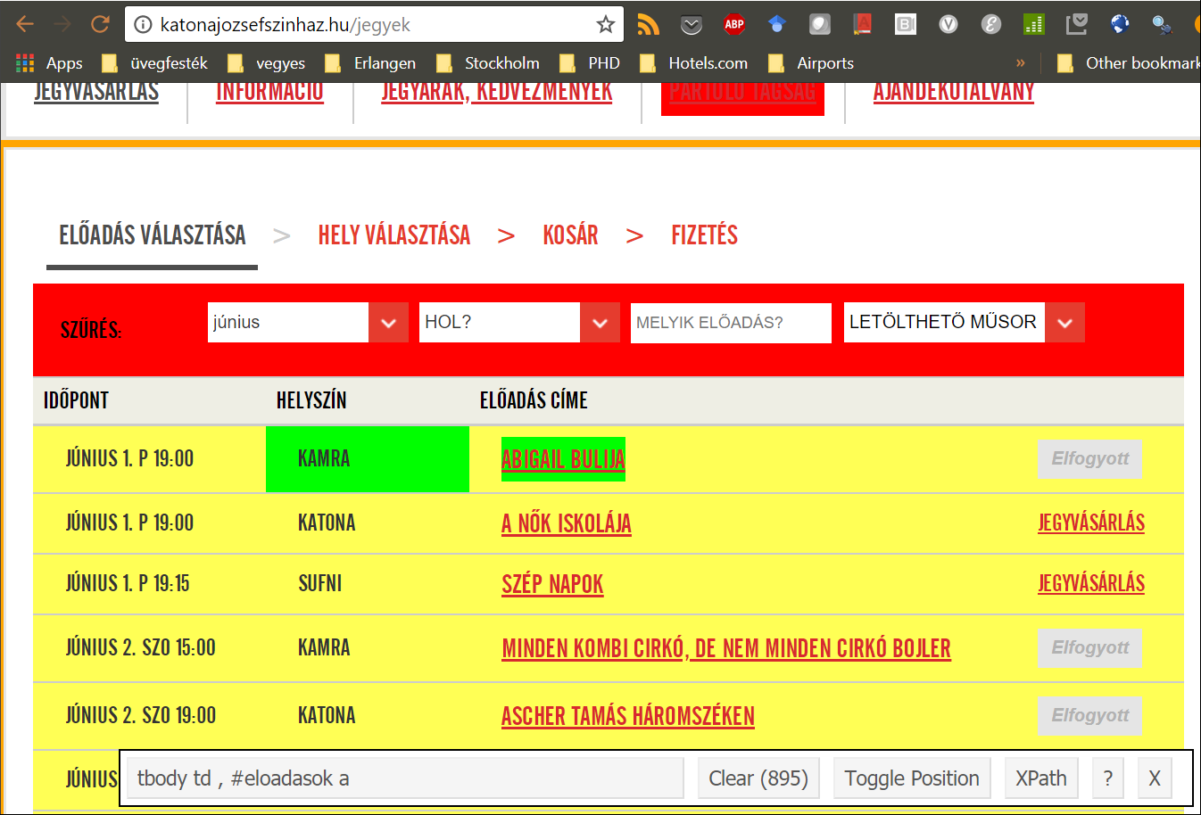
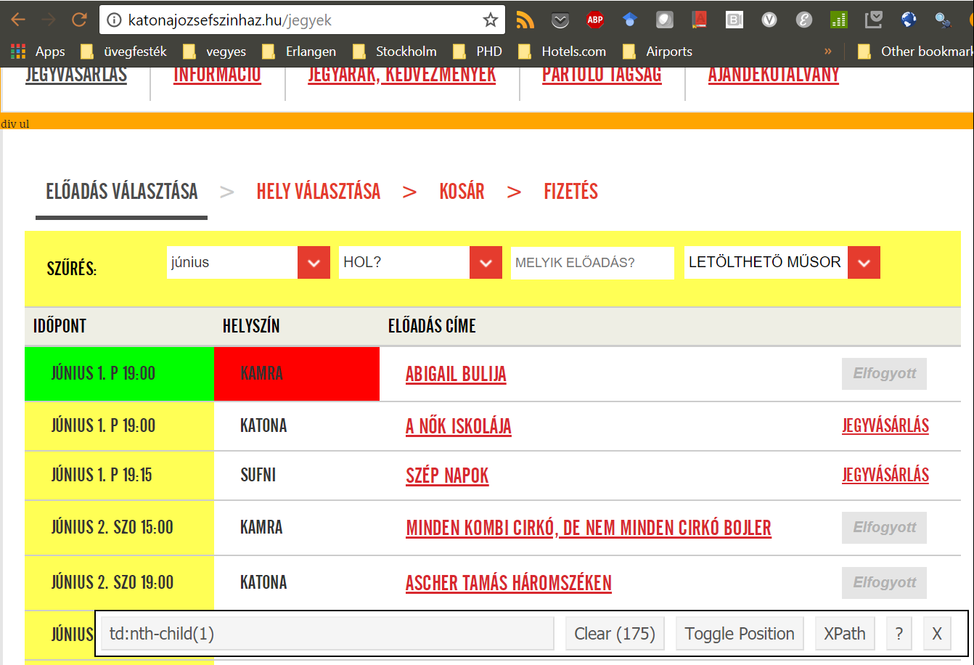
Scrape the website periodically
1
✓ Load the rvest package
library(rvest)
url_root <- "http://katonajozsefszinhaz.hu/jegyek"
webpage_root <- read_html(url_root)
for(i in 1:length(plays_titles)) {
current_date <- html_text(html_node(webpage_root,
paste0('tr:nth-child(', i,') td')))
current_location <- html_text(html_node(webpage_root,
paste0('tr:nth-child(', i, ') td:nth-child(2)')))
…
}
Selector Gadget Chrome Extension
✓ Define the root URL
URL of the webpage to be scraped
✓ Extract a particular field
Node ID of the items

Slide 6
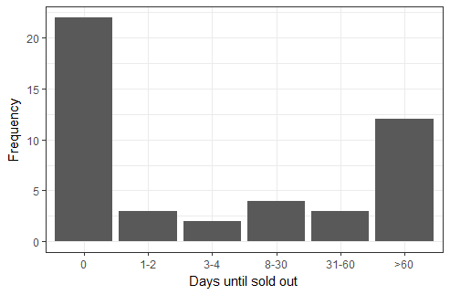
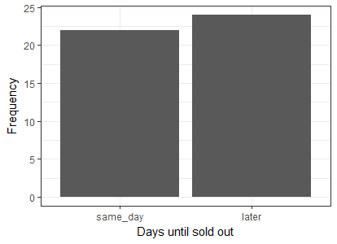
Feature engineering
2
Artists (actors, directors, etc.)
Number of events per month
Location
Price of the cheapest and most expensive ticket
Target: # days until sold out → sold out the same day or later

Slide 7

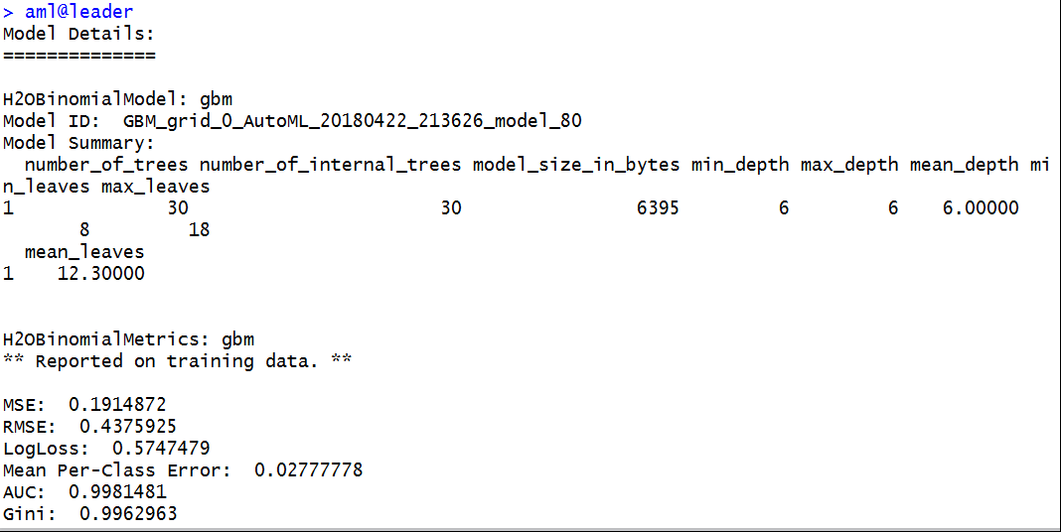
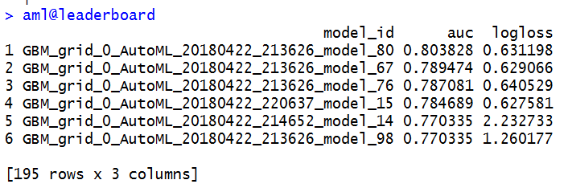
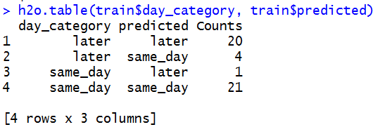
Model building
3
library(h2o)
h2o.init()
y <- "day_category"
x <- setdiff(names(train), y)
train <- as.h2o(train)
test <- as.h2o(test)
aml <- h2o.automl(x = x, y = y,
training_frame = train,
leaderboard_frame = test,
max_runtime_secs = 60)
aml@leaderboard
aml@leader
train$predicted <- h2o.predict(aml@leader, train)[, 1]
h2o.table(train$day_category, train$predicted)
✓ Load the h2o package and initiate the cluster
✓ Feature definition
✓ Conversion to H2O format
✓ Model building

Slide 8

Conclusions and acknowledgements
Location matters (smaller stage with 100 seats gets sold out quicker)
Number of events matters? (the more frequent is the play, the more quickly it gets sold out) → caused the most false positives in the validation phase
Only one actor which seems to “sell” the play
The same play was popular in April, not so much in June
Blog post on rvest (found on R-Ladies slack ☺): https://www.analyticsvidhya.com/blog/2017/03/beginners-guide-on-web-scraping-in-r-using-rvest-with-hands-on-knowledge/
H2O AutoML webinar (by our own R-Lady Erin LeDell): https://www.youtube.com/watch?v=j6rqrEYQNdo
gitHub repo for the code: https://github.com/salankia/Random-R-code-snippets/tree/master/theatre%20modeling

